Slide 1
Step 1: Create Account
Create your individual online giving account to give to
Grandville Baptist Church

Slide 2
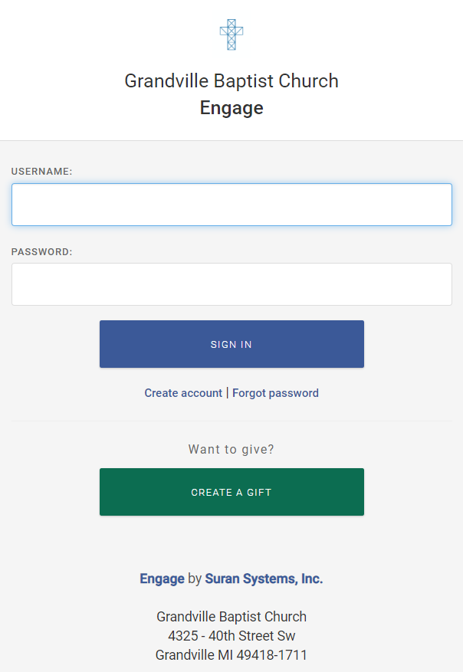
Create Account: Navigate to Engage
First go to the church website: https://grandvillebaptist.org/
Select GIVE – this will take you to the Grandville Baptist Church Engage page
Select Create account

Slide 3
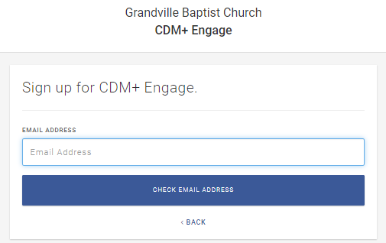
Create Account: Check email address
Login Screen
You will see a login screen
Enter your email address and then select CHECK EMAIL ADDRESS
Note: Engage uses your email address to link to your name with our CDM+ accounting software.
Enter your email address

Slide 4
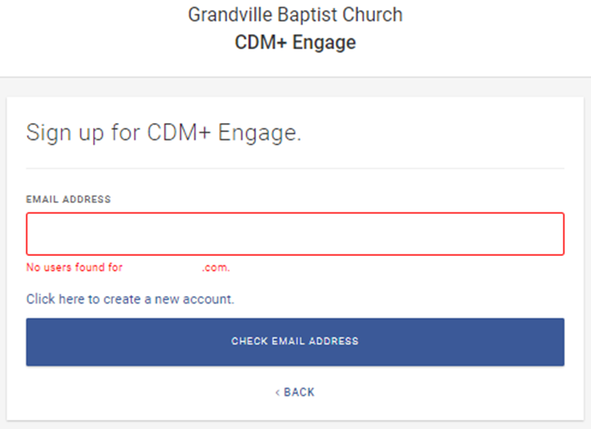
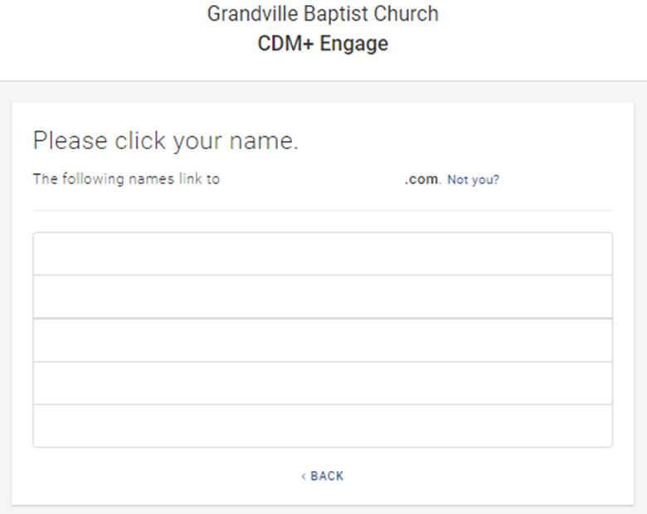
Create Account: Check email address results
You will get one of the following screens
No users found for <email address you entered>
The following names link to <email address you entered>
-OR-
Email address you entered
Not You?
Email address you entered
Your Name
email address you entered
Another name in your family

Slide 5
Create Account: No users found for <email address you entered>
If you see No users found for <email address you entered> follow the steps below. Otherwise skip this section
No users found for <email address you entered>
If the email address you entered does not match the email address linked to your name in our CDM+ accounting software, you will receive the following error: No users found for <email address you entered>.
Check to make sure you entered the correct email address. If you have entered your correct email address, please contact the church office via phone 616-534-8681 or email gbc@grandvillebaptist.org so that they can enter your correct email address to link to your name in our CDM+ accounting software before you proceed.
If you create an account with an email that does not match what we have in our CDM+ accounting software, it will create an additional account linked to your name in our CDM+ accounting software – which we prefer not to happen. Therefore, please do not select Click here to create a new account.
After the church office enters the correct email address, start the create account instructions from the beginning to create your account.
Email address you entered
Email address you entered

Slide 6
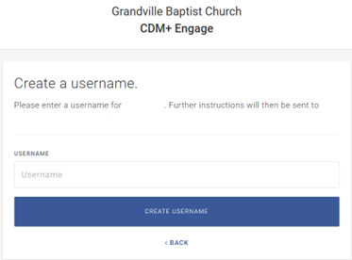
Create Account: The following names link to <email address you entered>
Your name(s) will show up if the email address you entered is linked to your name(s) in our CDM+ accounting software
Please select only one name that you want to use for your online giving account
Note: If the names listed are not you, please do not select Not You, but call or email the church office.
You will be asked to create a USERNAME. Enter your created USERNAME and select CREATE USERNAME.
Further instructions will be sent to the email address shown on the page.
The following names link to <email address you entered>
Your Name
email address you entered
Email address you entered
Your Name
Your Username
Another name in your family

Slide 7
Create Account: Create your password and log in
Create your Password
Log In
Check your email as Engage has sent an email to you that contains your username and instructions for creating a password. You can create a password by selecting Reset Password
After creating your password, you will be returned to the Engage login screen where you can log into Engage. Enter your username and password and select SIGN IN.
username
Enter your user name
Reset Password
Enter your password
36-character code provided by Engage

Slide 8
Step Two: Giving with an Account
Set up a recurring or one-time gift to Grandville
Baptist Church once you have created an account

Slide 9
Giving with an Account: Navigate to Engage
First go to the church website: https://grandvillebaptist.org/
Select GIVE – this will take you to the Grandville Baptist Church Engage page
Enter your USERNAME and PASSWORD
Select SIGN IN
Enter your user name
Enter your password

Slide 10
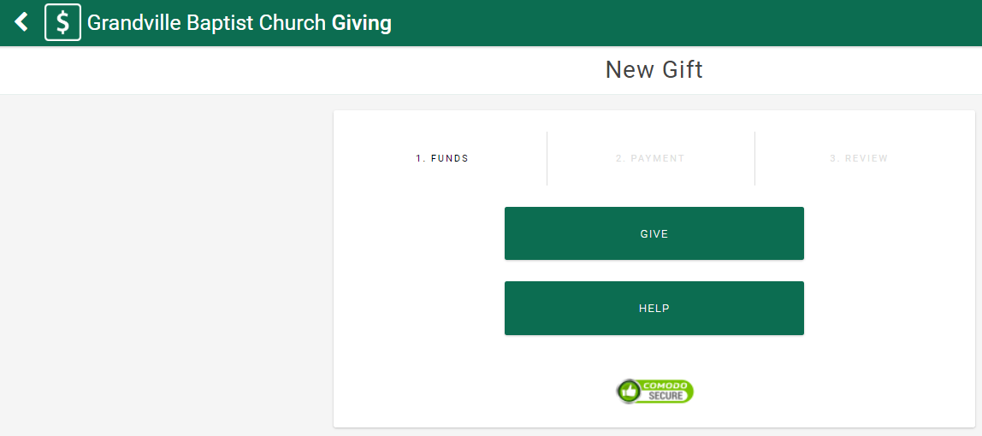
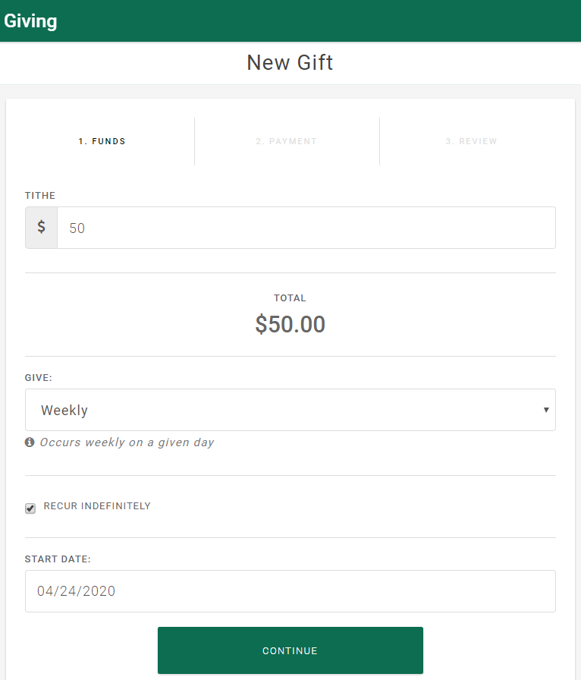
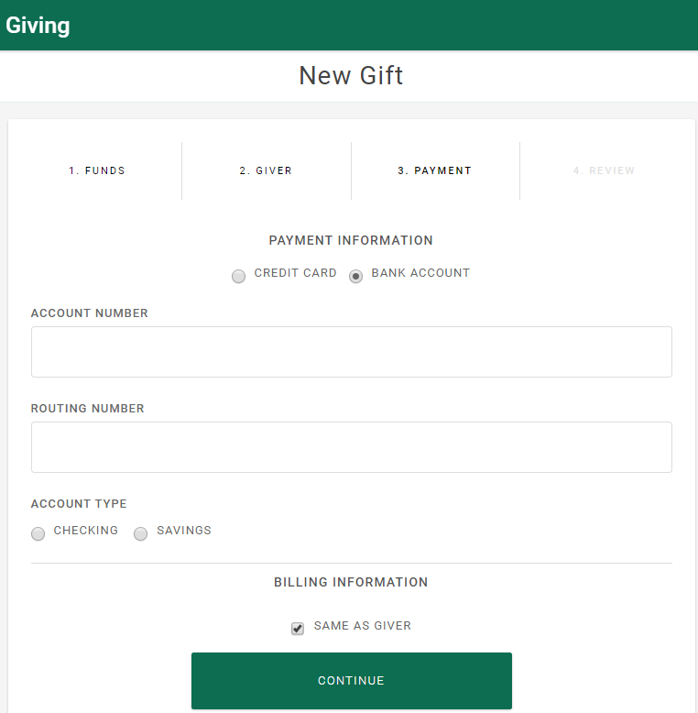
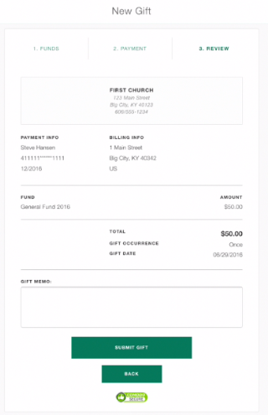
Giving with an Account: Recurring or one-time gift
Select GIVE
Enter Tithe Amount, select Frequency from the GIVE: drop down, select Recur Indefinitely (if desired), enter Start Date, select CONTINUE
Select Bank Account (Credit Cards have additional Fees), Enter where your funds will come from, select CONTINUE
If the information is correct select SUBMIT GIFT
Grandville Baptist Church
Address
Payment Info
Billing Info
Recurring
4/24/2020

Slide 11
Giving as a Guest without having an Account
Set up a one-time gift to Grandville
Baptist Church as a guest without having an account

Slide 12
Giving as a guest without having an Account: Navigate to Engage
First go to the church website: https://grandvillebaptist.org/
Select GIVE – this will take you to the Grandville Baptist Church Engage page
Note: This gift can be given anonymously but will not be available for year-end tax-deductible receipt.
Select CREATE A GIFT

Slide 13
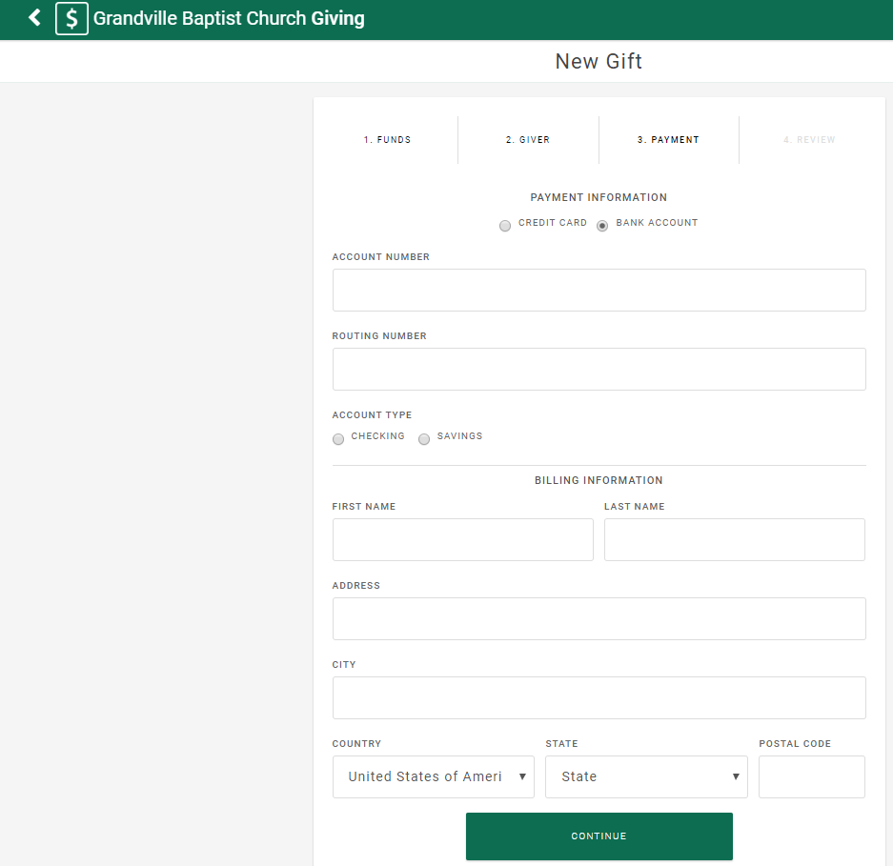
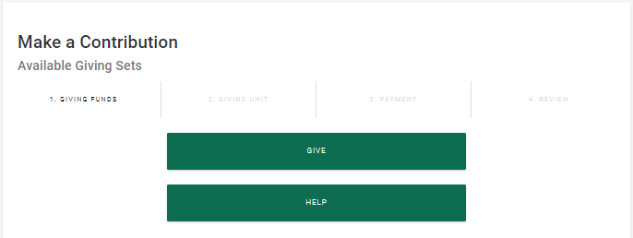
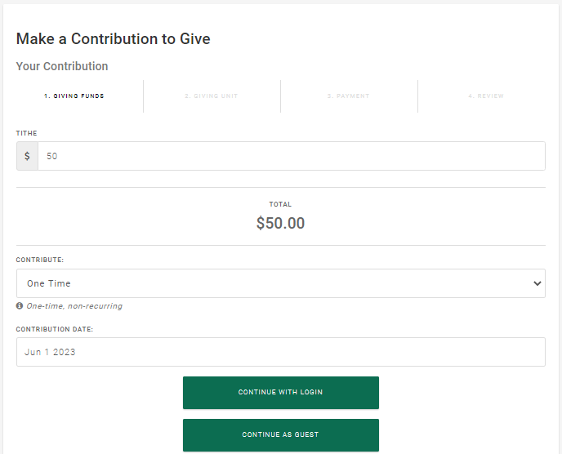
Giving as a guest without having an Account: One-time gift
Select GIVE
Enter Tithe Amount, enter Gift Date, select CONTINUE AS GUEST
Select Bank Account (Credit Cards have additional fees), Enter where your funds will come from, select CONTINUE
If the information is correct select SUBMIT GIFT
Grandville Baptist Church
Address
Payment Info
Billing Info
Recurring
4/24/2020

